Slide 1


LOG8848
Swapnil Prakash Shrestha
LC00017001100
5th Semester, 3rd Year

Slide 2
Outline:
Introduction
Problem Statement
Objective
Literature Review
Comparison
Gantt chart
Flow chart
Project Architecture
Conclusion
Future Expansion

Slide 3
Introduction
Log analysers are essential tools in modern IT and cybersecurity, automating the collection and analysis of event logs from various sources.
Anomaly detection is a critical aspect of log analysis, as it helps detect deviations from baseline behaviour that may indicate security threats or system issues.
These tools standardize log data, making it consistent and compatible, and then use pattern recognition and anomaly detection to identify regular activity patterns and anomalies
Log analysers generate alerts and notifications when anomalies or potential threats are detected, enabling timely responses from IT and security teams
These tools provide detailed reports and insights based on log data analysis, including information on security incidents, system performance, and compliance.
Log analysers continuously monitor incoming log data in real-time, integrate with other security tools, and archive data for compliance and forensic purposes, enhancing an organization's overall cybersecurity posture.
Programs are being developed day by day and being used day by day for different cyber-attacks.
Two types of team i.e., Red team and Blue team.
Port Scanning tool is usually used for reconnaissance and information gathering.
SQL injection is the process of injecting the vulnerable SQL queries in a website.
It would be easy if there is a tool that has both the combination of port scanning and SQL injection vulnerability detection.
Time saving
Dual functionality in a single tool.

Slide 4
Problem Statement
.
Port Scanning tool is usually used for reconnaissance and information gathering.
Two types of team i.e., Red team and Blue team.
SQL injection is the process of injecting the vulnerable SQL queries in a website.
It would be easy if there is a tool that has both the combination of port scanning and SQL injection vulnerability detection.
O-port has the combination of both the port scanning and SQL vulnerability detection, done in less amount of time.
Programs are being developed day by day and being used day by day for different cyber-attacks.
Two types of team i.e., Red team and Blue team.
Port Scanning tool is usually used for reconnaissance and information gathering.
SQL injection is the process of injecting the vulnerable SQL queries in a website.
It would be easy if there is a tool that has both the combination of port scanning and SQL injection vulnerability detection.
Time saving
Dual functionality in a single tool.

Slide 5
Objective
Develop Advanced Literature Review: Techniques
Detect Anomalies and Patterns: Find strange things, patterns, and trends in event logs using different models. These could point to possible security risks or problems.
Create a simple, open-source Literature Review: tool that is free to use and requires little effort to setup and use
Log Parsing: Make programs that can correctly read both organized and unstructured log files.
Programs are being developed day by day and being used day by day for different cyber-attacks.
Two types of team i.e., Red team and Blue team.
Port Scanning tool is usually used for reconnaissance and information gathering.
SQL injection is the process of injecting the vulnerable SQL queries in a website.
It would be easy if there is a tool that has both the combination of port scanning and SQL injection vulnerability detection.
Time saving
Dual functionality in a single tool.

Slide 6
Literature Review
Experts says that port scanning in reconnaissance and SQL injection in attacking are one of the most growing cyber threats in today’s world.
Ralph Bonnell said- “The simplest and most popular form of network surveillance is port scanning, particularly across numerous workstations”.
Joe Ariganello said- “The majority of their time is spent chasing false positives and carrying out manual processes that were created by these various toolkits”.
Many cyber security professionals face time scarcity in using port scanning tools like Nmap, Zenmap etc.

Slide 7
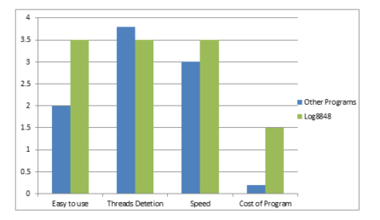
Comparison

Slide 8
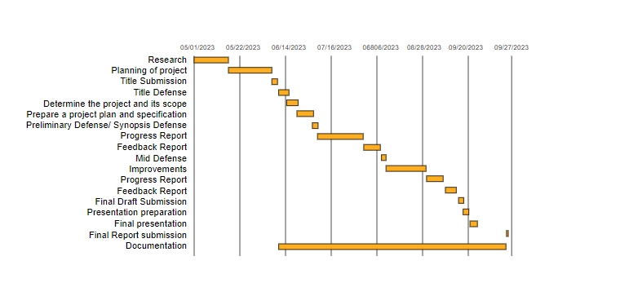
Comparison

Slide 9
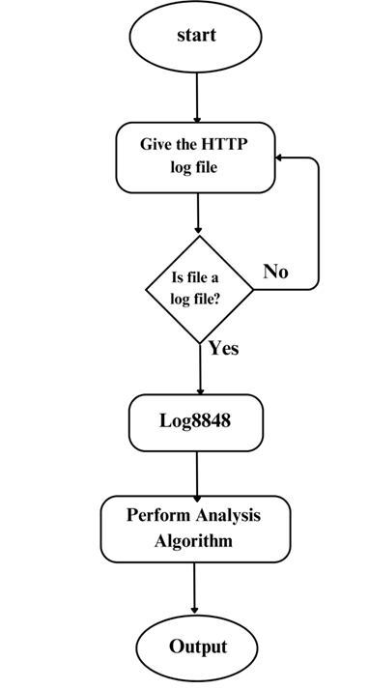
Flow Chart

Slide 10
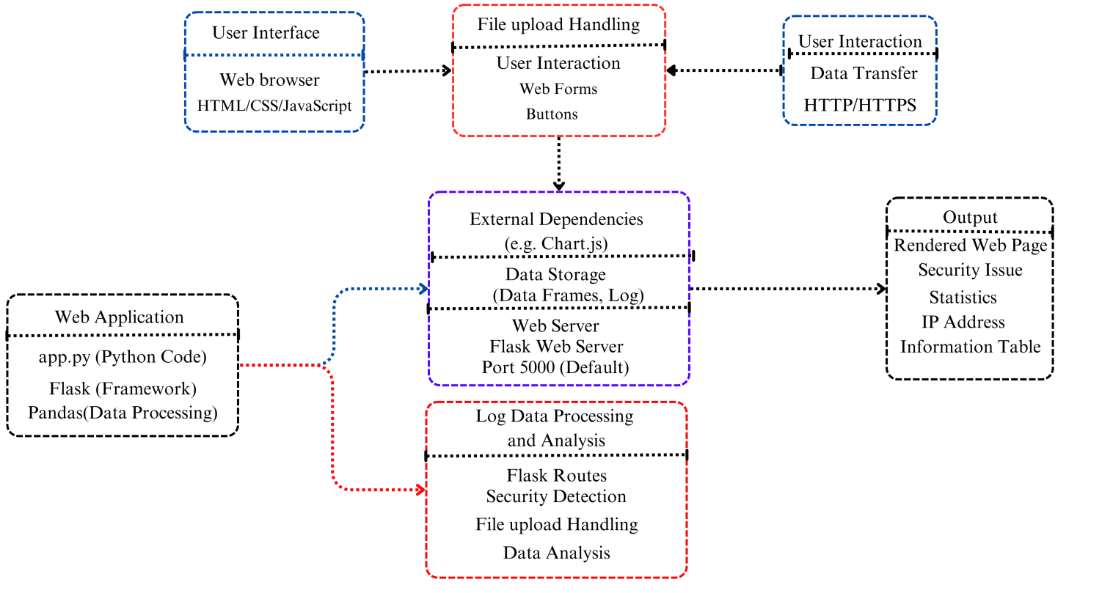
Architecture

Slide 11
Conclusion
Log8848 demonstrates its efficacy as a robust Python-based solution that effectively fulfills the diverse needs of cybersecurity professionals.
This tool facilitates the identification of accessible ports on servers and systems while operating in a defensive posture, allowing for continuous monitoring and offering defense against potential assaults.
O-port serves as a multifunctional and indispensable instrument that facilitates the process of conducting port scanning and detecting SQL injection vulnerabilities.

Slide 12
Future Expansion
Real-Time Analysis
Custom Security Rules
Machine Learning and Anomaly Detection
Allow for the saving of scan findings to a database or file.
Permit users to choose an IP address range to scan several hosts.
Allow for the export of scan results in a structured format (like JSON or CSV).

Slide 13
References
"python-time" on PyPI, (2023) Available at: https://pypi.org/project/python-time/ (Accessed: 06 September 2023).
"sockets" on PyPI, (2023) Available at: https://pypi.org/project/sockets/ (Accessed: 06 September 2023).
"thread6" on PyPI, (2023) Available at: https://pypi.org/project/thread6/ (Accessed: 06 September 2023).
Python argparse documentation, (2023) Available at: https://docs.python.org/3/library/argparse.html#:~:text=The%20argparse%20module%20makes%20it,generates%20help%20and%20usage%20messages (Accessed: 06 September 2023).
"The Latest Cyber Crime Statistics" on aag-it.com, (2023) Available at: https://aag-it.com/the-latest-cyber-crime-statistics/ (Accessed: 06 September 2023).

